Slide 1
CS 540 Network Architecture
Lecture 15 : SDN/NFV and P4
Prof. Younghee Lee

Slide 2


Software Defined Networking
Separates the control plane from the data plane in network switches and routers
Control plane: implemented in S/W in servers
Data plane: implemented in commodity network equipment
OpenFlow: a leading SDN architecture
Which problems?
Application: No control to networks
No network optimization to the applications
Hard to guarantee the QoS
Static network management
Too complex function and standards for 4G apps.(IMS, Parley..)
Where to use?: KT, SKT, LGU+, Daum, (NHN)…
Cloud networking: Google announced that they achieve 100% network utilization (normally 40%)
Mobile Network Control adaptive to dynamic app traffic behavior
Resource virtualization, elasticity and aggregation to reduce OPEX & CAPEX
Home networks?
not mature to deploy for ISP
“If header = x, send to port 4”
“If header = y, overwrite header with z, send to ports 5,6”
“If header = ?, send to me”
Flow
Table
Environmental changes lead evolution: Now is time to escape from ossification?
OPEX: Operational expenditures
CAPEX: Capital expenditures

Slide 3
Open flow vs SDN
Q: What’s the difference between SDN and the OpenFlow Standard?
A:
The OpenFlow standard is a foundational element for SDN.
SDN is an emerging network architecture where network control is decoupled from forwarding and is directly programmable.
The OpenFlow Standard is the first standard communications interface defined between the control and forwarding layers of a software-defined network architecture
Open Networking Foundation (ONF)
New non-profit standards organization (Mar 2011), Defining standards for SDN, starting with OpenFlow
https://www.opennetworking.org/

Slide 4
OpenFlow
IP Ossification => toward
Adoptable, self defined network rather than standard
Programmable Network
Give some network control to application
with open interface
Enabling innovation on campus
Standard way to control flow-tables in commercial switches and routers
* Some part of this teaching materials are prepared referencing the material of OpenFlow Hands-on Tutorial part of the the Open Networking Summit, Stanford University Oct 17, 2011 by Mr. Brandon Heller, Papers & presentation materials of Prof. Mckeown etc.,

Slide 5
OpenFlow: A Software Defined Networks
App
App
App
App
App
App
Controller 1
Controller
2
Windows
(OS)
Linux
Mac
OS
Controller 1
Controller
2
Network Virtualization
Windows
(OS)
Linux
Mac
OS
Controller 1
Controller
2
Windows
(OS)
Linux
Mac
OS
Virtualization
Virtualization (FlowVisor)
x86
(Computer)
OpenFlow
Simple, common, stable, hardware substrate below
+ Programmability + Strong isolation model
+ Competition above
→ Faster innovation

Slide 6
OpenFlow building blocks
oftrace
oflops
openseer
Monitoring/ debugging tools
Stanford Provided
ENVI (GUI)
LAVI
n-Casting
Expedient
Applications
NOX
Beacon
Helios
Maestro
SNAC
Controller
Slicing
Software
FlowVisor
Console
FlowVisor
Commercial Switches
Stanford Provided
Software
Ref. Switch
NetFPGA
Broadcom
Ref. Switch
HP, NEC, Pronto, Juniper.. and many more
OpenFlow
Switches
OpenWRT
PCEngine WiFi AP
OpenVSwitch
6
Notes:
There are components at different levels that work together in making it work
The commercial switch details will follow in next slide
There are a plethora of applications possible. I only list those available at Stanford

Slide 7
OpenFlow building blocks
OpenFlow software switch Options
Reference Linux Switch
NetFPGA Switch: line-rate performance for 4 Gigabit ports
Open vSwitch: multilayer virtual switch,
OpenFlow Controller Options
NOX: Network Operating System that supports OpenFlow switches
Beacon: an extensible Java-based OpenFlow controller.
Helios: an extensible C-based OpenFlow controller build by NEC
BigSwitch: a closed-source controller based on Beacon that targets production enterprise networks
SNAC: a controller targeting production enterprise networks based on NOX0.4
Maestro: an extensible Java-based OpenFlow controller released by Rice Univ.

Slide 8
OpenFlow building blocks
FlowVisor:
a special purpose OpenFlow controller that acts as a transparent proxy between OpenFlow switches and multiple OpenFlow controllers.
It slices the network based on the Flow fields and allocated the “flowspace” to individual controllers.
It ensures that each controller touches only the switches and resources assigned to it.
It partitions bandwidth and flow table resources on each switch and assigns those partitions to individual controllers.
It enables multiple controllers to operate the same physical infrastructure
much like a server hypervisor allows multiple operating systems to use the same x86-based hardware.
OpenFlow controllers then operate their own individual network slices through the FlowVisor proxy.
This allows multiple OpenFlow controllers to run virtual networks on the same physical infrastructure.

Slide 9
OpenFlow Basics
Control Program A
Control Program B
Network OS
Rule and Action
“If header = p, send to port 4”
Packet
Forwarding
Rules map to packet header
“If header = q, overwrite header with r, add header s, and send to ports 5,6”
“If header = ?, send to me”
Flow
Table(s)
Packet
Forwarding
Packet
Forwarding

Slide 10
Design Concepts
Isolation: Regular production traffic untouched
Separate intelligence (control) from the path
Virtualized and programmable: Different flows processed in different ways
Open development environment for all researchers (e.g. Linux, Verilog, etc).
Flexible definitions of a flow
Individual application traffic
Aggregated flows: Slice(range)
Alternatives to IP running side-by-side => To be compatible with IP
…

Slide 11
Open Flow Switching
User defined processing
OpenFlow Controller
OpenFlow Protocol (SSL/TCP)
Control Path
OpenFlow
Data Path (Hardware)

Slide 12
Flow Table Entry “Type 0” OpenFlow Switch
Rule
Action
Stats
Remember? Packet classification with rules & actions
Or Match
Simple actions
Packet + byte counters
Forward packet to port(s)
Encapsulate and forward to controller
Drop packet
Send to normal processing pipeline
Switch
Port
MAC
src
MAC
dst
Eth
type
VLAN
ID
IP
Src
IP
Dst
IP
Prot
TCP
sport
TCP
dport
+ mask

Slide 13
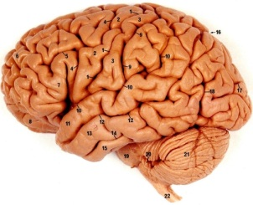
Cache decisions in minimal flow-based datapath
“If header = x, send to port 4”
“If header = y, overwrite header with z, send to ports 5,6”
“If header = ?, send to me”
Flow
Table

Slide 14
Substrate: “Flowspace”
Ethernet
DA, SA, etc
IP
DA, SA, etc
TCP
DP, SP, etc
Payload
Collection of bits to plumb flows
(of different granularities)
between end points
Header
User-defined flowspace
Payload
“OpenFlow 2.0”

Slide 15
Flowspace: Simple example
Single flow
All flows from A
All flows between two subnets
IP DA
A
IP SA

Slide 16
Flowspace: Generalization
Single flow
Set of flows
Field 1
Field 2
Field n

Slide 17
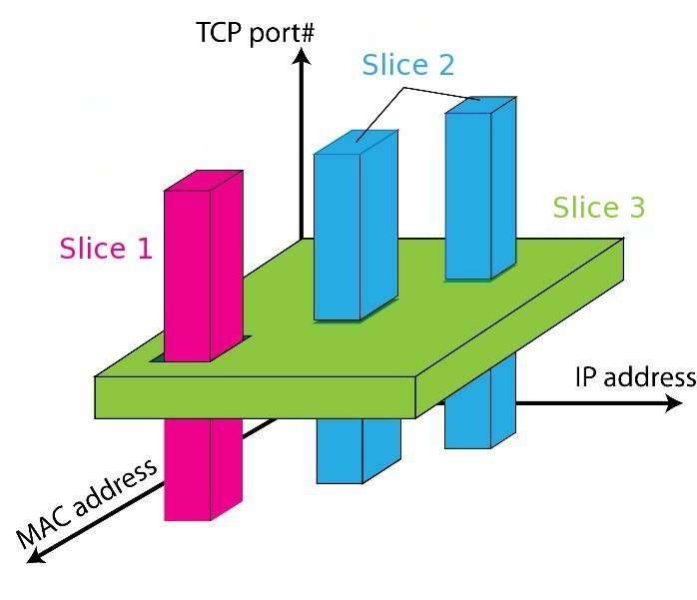
Flowspace: Maps Packets to Slices

Slide 18


Slicing using VLANs Sliced OpenFlow Switch
Controller C
C VLANs
Controller B
Flow Table
B VLANs
Controller A
Flow Table
A VLANs
Flow Table
(Legacy VLANs)
Normal L2/L3 Processing

Slide 19
FlowVisor
A proxy between switch and guest controller
It slices the network based on the Flow fields and allocated the “flowspace” to individual controllers.
Network Virtualization
Parses and rewrites OpenFlow messages as they pass
Ensures that one experiment doesn’t affect another
Isolation
Allows rich virtual network boundaries
By port, by IP, by flow, by time, etc.
Define virtualization rules in software
Rob Sherwood∗, Glen Gibb†, Kok-Kiong Yap†, Guido Appenzeller†, Martin Casado#, Nick McKeown†, Guru Parulkar†
∗ Deutsche Telekom Inc. R&D Lab, † Stanford University, #Nicira Networks
“FlowVisor: A Network Virtualization Layer”, OPENFLOW-TR-2009-1

Slide 20

FlowVisor
Rob Sherwood* (rob.sherwood@stanford.edu)
Alice’s
Controller
Bob’s
Controller
OpenFlow
Protocol
OpenFlow
Switch
FlowVisor
OpenFlow
Protocol
OpenFlow
Switch
OpenFlow
Switch
* Deutsche Telekom, “T-Labs”

Slide 21

FlowVisor
WiMax-WiFi
Handover
Tricast Lossless
Handover
GENI
Learning
switch
Mobile VMs
New BGP
Bob’s
FlowVisor
Alices’s
FlowVisor
GENI’s
FlowVisor
GENI
Aggregate Manager
Production
Network
Controller
OpenFlow Protocol
Network Administrator’s
FlowVisor
OpenFlow Protocol
OpenFlow
Switch
OpenFlow
Switch
OpenFlow
Switch

Slide 22
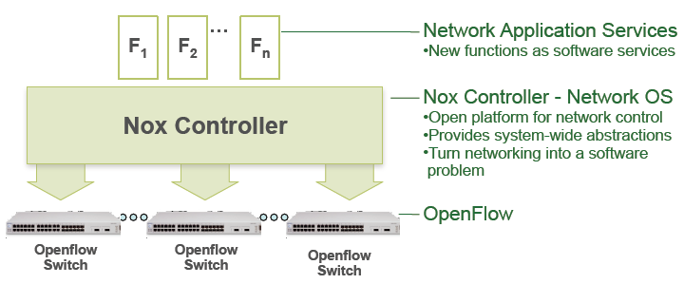
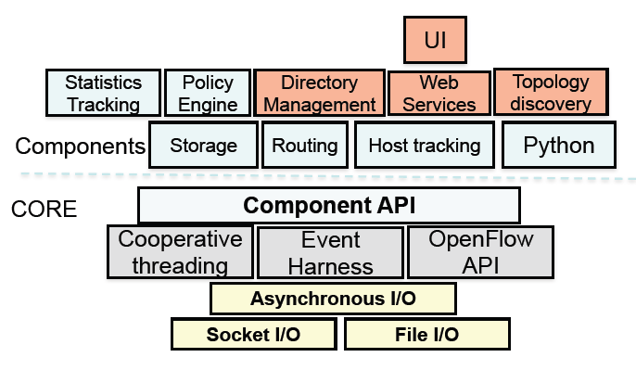
NOX: A Network OS for OpenFlow

Slide 23

Why open system? Data Center
Example: New data center
Cost
200,000 servers
Fanout of 20 a 10,000 switches
$5k commercial switch a $50M
$1k custom-built switch a $10M
Savings in 10 data centers = $400M
Control
Optimize for features needed
Customize for services & apps
Quickly improve and innovate

Slide 24
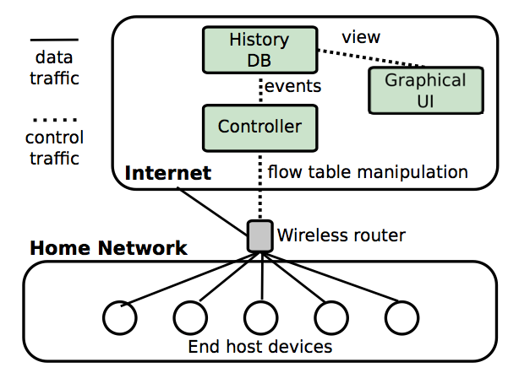
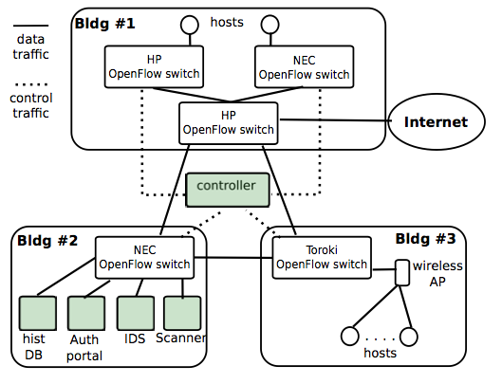
Two Real-World Deployments
http://projectbismark.net/
Usage control in home networks
Implementation of user controls (e.g., usage cap management, parental controls) in home networks
Today: Not possible
With SDN: Intuitive, simple
Access control in enterprise networks
Re-implementation of access control on the Georgia Tech campus network
Today: Complicated, low-level
With SDN: Simpler, more flexible

Slide 25
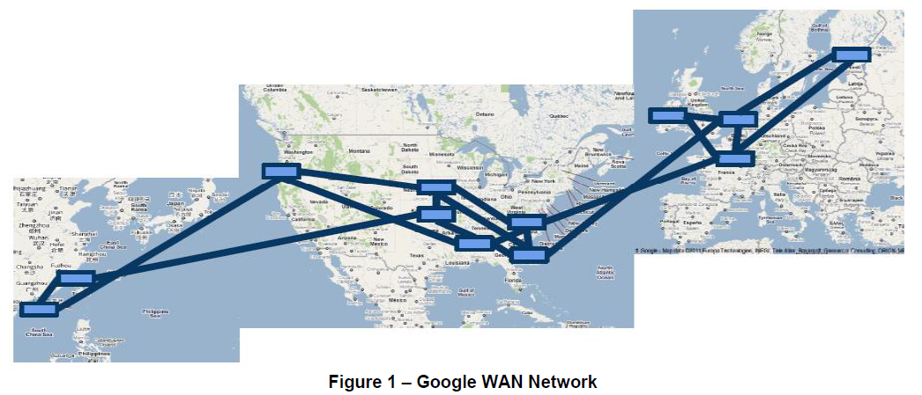
SDN use case – google inter-datacenter
Why?
significant amount of data to be moved from one region to another
Need Inter-Datacenter WAN with centralized Traffic Engineering(TE) using SDN and OpenFlow
Problem?
non-linear complexity in management and configuration.”
Source: “Migration Use Cases and Methods”, Migration Working Group, ONF 2013

Slide 26
Open Flow: summary
www.openflow.org/wk/index.php/OpenFlow_Tutorial
Many SDN vendors, switch vendors
Can co-exist with legacy ip network

Slide 27
OpenFlow: Discussions
How much innovative is it?
What is the magic for big success?
Are there complete OpenFlow solution for ISP?
Can it co-exist with legacy ip network?
Cost Performance???
Additional value > Transition cost : ???
Are they in rose garden?
What will be the next step?

Slide 28
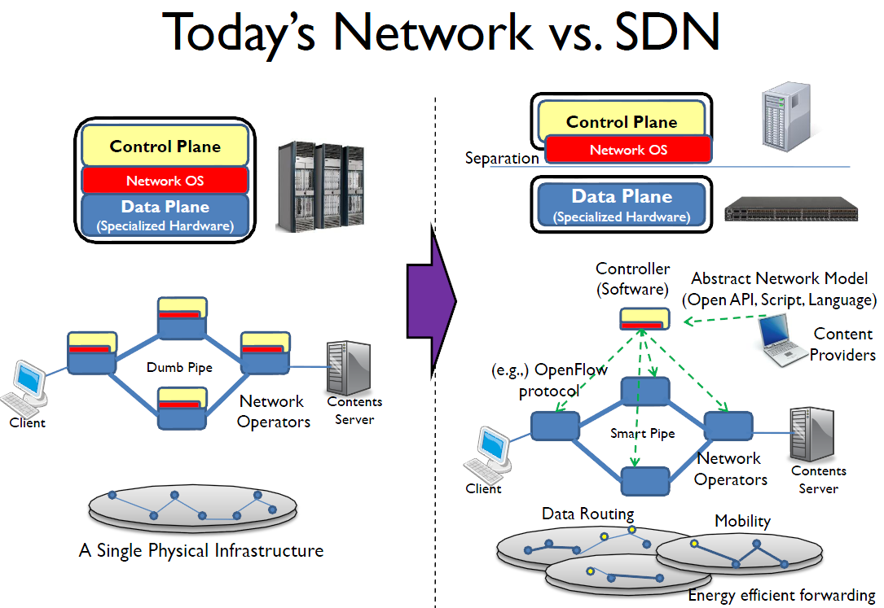
Software Defined Networking
Vender’s equipment OS

Slide 29
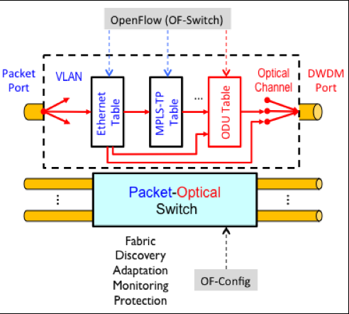
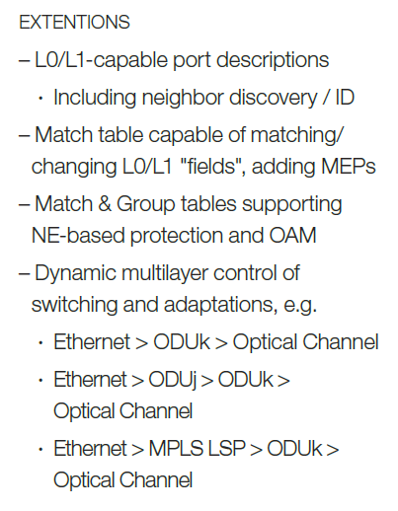
OpenFlow-enabled Transport SDN
Target multi-layer OpenFlow logical switch model: ONF

Slide 30
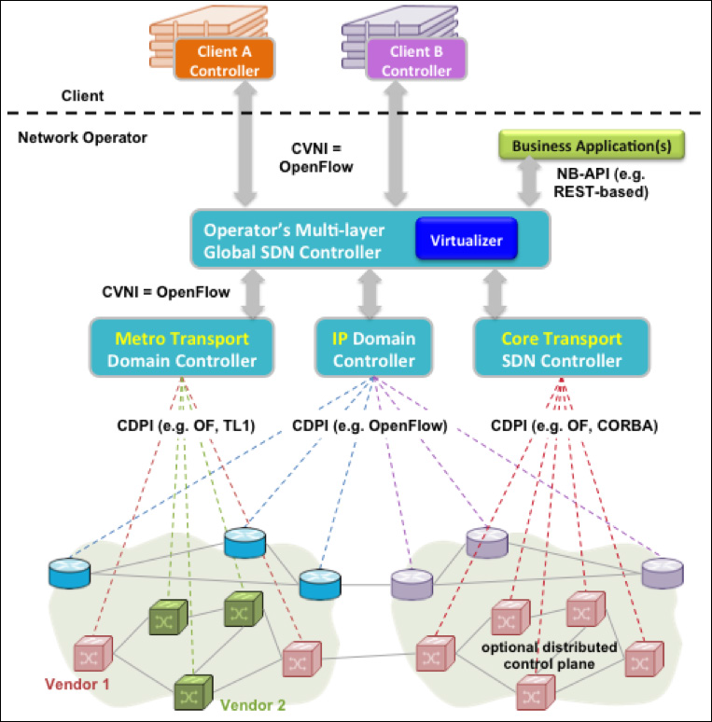
OpenFlow-enabled Transport SDN
Hierarchical control architecture: ONF

Slide 31
SDN in development
Application Domains
Data centers
Enterprise/campus
Cellular backhaul
network aware applications
application aware networks
Enterprise WiFi
WANs
Products: now much more…
Switches, routers: About 15 vendors
Software: About 6 vendors and startups

Slide 32
Cellular industry: They claim
Recently made transition to IP
Billions of mobile users
Need to securely extract payments and hold users accountable
IP is bad at both, yet hard to change
Why?
SDN enables industry to customize their network
How?

Slide 33
Network Functions Virtualization
Why?
Shorter lifecycles of network equipment
Need to reduce CAPEX, OPEX by flexible and agile network resources
Need to launch timely new services: SW oriented innovation
How?
Implementing network functions in software by IT virtualization over high capacity standard servers
applications
applications
operating systems
network functions
hypervisors
operating systems
compute infrastructure
hypervisors
network infrastructure
compute infrastructure
switching infrastructure
switching infrastructure
rack, cable, power, cooling
rack, cable, power, cooling
“Network Functions Virtualisation”, Bob Briscoe, Chief Researcher BT 2013
Hypervisor:
software layer providing the virtualization
a virtual machine monitor

Slide 34








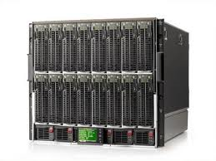

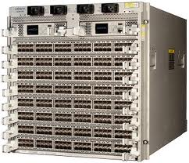
NFV ecosystem
Current network appliance
Dedicated HW per site
Hard to develop and to deploy new innovative services
Separated Message router, CDN, DPI, Firewall, Carrier grade NAT, QoE monitor, Radio access nodes……
With NFV
Competitive, innovative open ecosystem over High capacity servers, storages and switches
Independent
Software Vendors
Orchestrated,
automatic
remote install
hypervisors
Generic High Volume Servers
Generic High Volume Storage
Generic High Volume
Ethernet Switches

Slide 35
Synergies btw SDN, NFV, NV
SDN: Virtualization of control/management aspect
NFV: Virtualization of (network) service aspect
Network virtualization(NV): Virtualization of network aspect
SDN + NFV
Control network flows for optimizing NFV performance

Slide 36
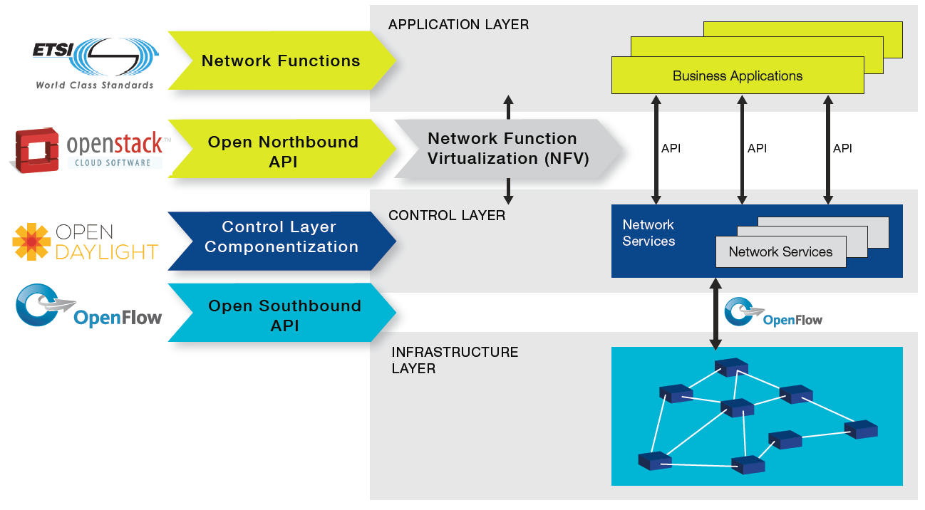
Synergies btw SDN, NFV, NV
NFV and SDN Industry Map of ONF

Slide 37
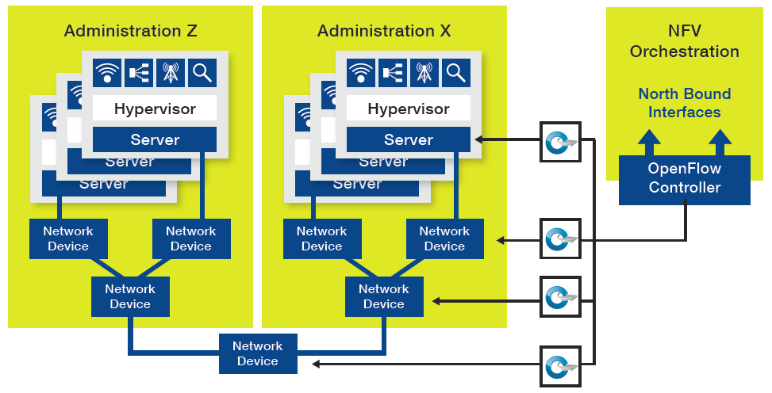
Synergies btw SDN, NFV, NV
OpenFlow-enabled SDN benefits for NFV: ONF

Slide 38

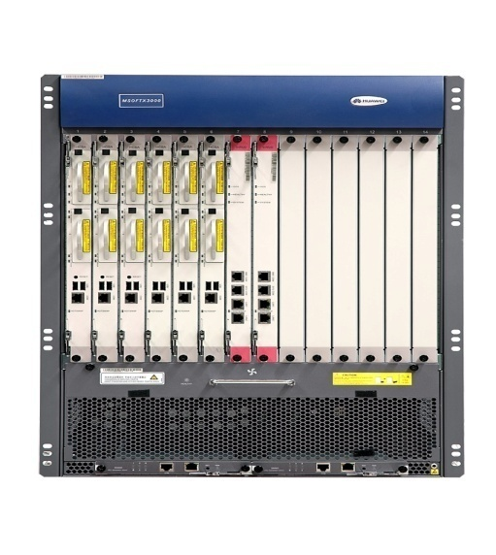
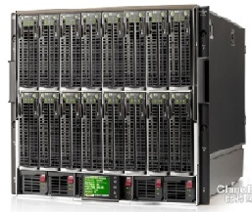

NFV HL Architecture and Scope - ETSI
OSS / BSS
NFV Scope
Virtualized Network Functions (VNFs)
NFV Management and
Orchestration (MANO)
Service
End-Points (End-users,
Other Services)
VNF
VNF
VNF
VNF
NFV Infrastructure (NFVI)
Virtual Infrastructure
Virtual
Computing
Virtual
Storage
Virtual
Networking
Other Networks
Physical Infrastructure
Compute
Storage
Network
Geneva, Switzerland, 4 June 2013

Slide 39
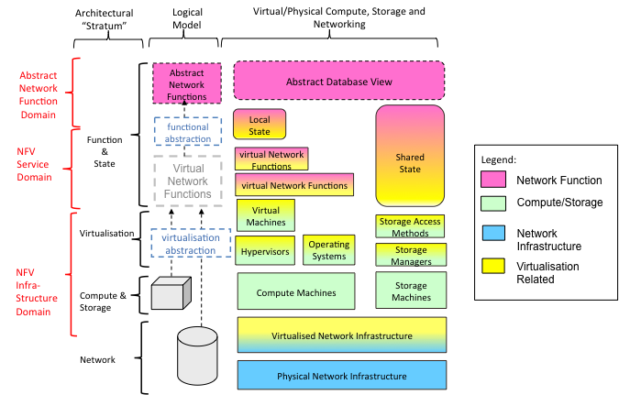
NFV architectural model - ETSI

Slide 40
Hypervisor
Hypervisor
Creates Virtual CPUs, Virtual NICs, Virtual Ethernet switch
NFV Hypervisor
Direct binding of VM to core
Direct path btw VMs and NIC
VM
VM
VM
...
VM
NfV Hypervisor
Virtual
machine mgt and API
Sequential thread emulation
vSwitch
instruction policing, mapping and emulation
...
NfV performance
hardware
NIC
core
core
core

Slide 41
Telco Operators: They claim
Global IP traffic growing 40-50% per year
End-customer monthly bill remains unchanged: XXX
Therefore, CAPEX and OPEX need to reduce 40-50% per Gb/s per year
But in practice, reduces by ~20% per year
SDN enables industry to reduce OPEX and CAPEX
…and to create new differentiating services
How?
Capital expenditure (CAPEX)
Operating expense (OPEX)
http://www.etnews.com/20141104000234

Slide 42
Telco Operators: CAPEX, OPEX
“In the SDN architecture, the control and data planes are decoupled, network intelligence and state are logically centralized, and the underlying network infrastructure is abstracted from applications” ONF White Paper
New services for new revenue => short life cycle
CAPEX should be limited.
Software defined network can help to reduce CAPEX for new services? (Optimistic) => possible?
Thanks to decoupling S/W development from H/W
Open Source S/W will play key role (Antonio Manzalini, TELECOM ITALIA GROUP)
Stateful network services with stateless IP?: skepticism
OPEX reduction: Automatic operation

Slide 43
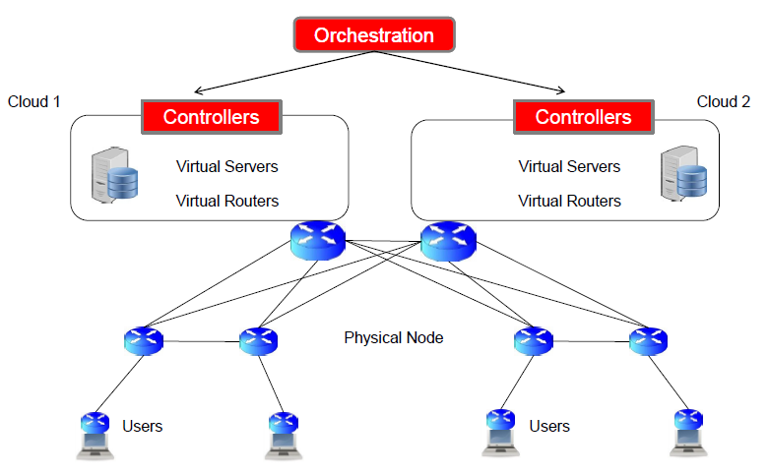
A SDN Use Case
(Antonio Manzalini, TELECOM ITALIA GROUP)
TELCO: Extremely conservative: Innovation? Short life cycle services?
SDN flexibility passes through the dynamic allocation/migration of ensembles of VMs and the associated data (e.g. configurations, rule) whilst keeping network states consistent

Slide 44
SDN Pros & Cons (Antonio Manzalini, TELECOM ITALIA GROUP)
Pros
Decoupling H/W from S/W
(same evolution of PC)
Network OS: logically centralized control
Network programmability (API)
Opportunity of complementing with network virtualization
Reducing time to market
Saving Capex and Opex
Cons
Scalability and performance ? (h/w speedup required in core nodes): States
Consistency of network states
(data) when logically centralizing the control ?
Signaling overhead ?
Availability, Complexity, Stability?
Quite convincing for the Edge, not for the Core…

Slide 45
What about standards
Networks need Standards that will define the interfaces
The role of standards will change:
Network owners will define network behavior
Features will be adopted without standards
Programming world
Good software is adopted, not standardized
SDN(with standards) + Open sources + Cloud =>
New ecosystem : free (service + network) platform?

Slide 46
Virtualization
Service Virtualization
focuses on providing a common infrastructure for building and managing a complex service ecosystem.
an emerging trend in the SOA
landscape
Server Virtualization
Storage Virtualization
End-to-end virtualization: Overlay
multiple virtual networks established end-to-end over shared physical infrastructure and resources:
multiplicity of end-user devices, computing, storage, communication networks, providers and service domains
Network Virtualization
a method of combining the available resources in a network by splitting up the available bandwidth into channels
Differences with Virtual Private Network?: Standard/Programmability?

Slide 47
Good references
https://www.youtube.com/watch?v=u3zEWsole6o
Nick McKeown ECE Colloquium: Programming the Forwarding Plane
Very good introduction to P4, SDN and historical backgrounds
https://www.youtube.com/watch?v=fAEVYQH2BKA
DC.p4: Programming the Forwarding Plane of a Data-Center Switch, SOSR 2015

